Slide 1


JEPPIAAR INSTITUTE OF TECHNOLOGY
“Self-Belief | Self Discipline | Self Respect”
Department of Electronics and communication Engineering
Subject Name : MICROPROCESSOR AND MICROCONTROLLER Presentation Title: INTERFACING THE LED USING 8086 MICROPROCESSOR
Team Members:
Students Name Reg.No:
1. TONIE RAALPH .C 210617106081
2. ALWIN REVANTH.P 210617106007
3. KRISHNA KUMAR.S 210617106050
4. SANGAVI.L 210617106070
5. SURYA PRABHA.S.V 210617106078

Slide 2
OBJECTIVE:
Know that how to work a 8086 microprocessor
Show the different parts of a 8086 microprocessor internal architecture

Slide 3
CONTENTS
INTRODUCTION
8086 TRAINER BOARD
LED(light emitting diode)
INTERFACING LED
INTERFACING LED WITH 8086
PIN ASSIGNMENT WITH 8086
CIRCUIT DIAGRAM
ASSEMBLY PROGRAM TO ON AND OFF LED USING 8086

Slide 4
INTRODUCTION
8086 MICROPROCESSOR:
8086 microprocessor is the enhanced version of 8085 microprocessor. It
was designed by Intel in 1976.
The 8086 microprocessor is a 16-bit, N-channel, HMOS microprocessor.
Where the HMOS is used for "High-speed Metal Oxide Semiconductor".
8086 is built on a single semiconductor chip and packaged in a 40-pin ICpackage. The type of package is DIP (Dual Inline Package).
8086 uses 20 address lines and 16 data- lines. It can directly address up to
220 = 1 Mbyte of memory
It consists of a powerful instruction set, which provides operation like
division and multiplication very quickly.

Slide 5
Features of 8086 Microprocessor:
1. To improve the performance of this microprocessor there are two stages of pipelining, which are fetching & execute stage.
2. The fetch stage can transfer the data in 6 bytes of instructions and stored in a line
3. The execute stage will execute the instructions
4. The 8086 microprocessor consists of 2900 transistors and it has 256 vectored interrupts
5. It is the first 16-bit processor with 16 bit ALU & register, internal data bus and 16-bit external data bus.

Slide 6
8086 TRAINER BOARD:
PS- TRAINER-8086 microprocessor trainer kit is proposed to smooth the progess of learnng and developing designs of microprocessor from intel. It has the facility to connect pc’s 101/104 keyboard, to enter the user program in assembly languages. User verifies the program through LCD or PC , user friendly filmware confirms facilitating the beginners learns operations of a microprocessor quickly.
LED ( light emitting diode):
light emitting diodes is the most commonly used comp[onents, usually for displaying pins digital states. Typical uses of LEDs include alarm devices, timers and confirmation of user input such as a mouse click or keystroke.

Slide 7
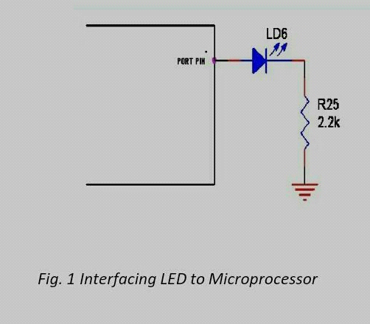
INTERFACING LED:
fig.1 shows how to interface the LED to microprocessor. As you can see the anode is connected through a resister to GND & the cathide is connected to the microprocessor pin. So when the port pin is HIGH the LED is OFF 7 when the port pin is LOW the LED is turned ON.

Slide 8
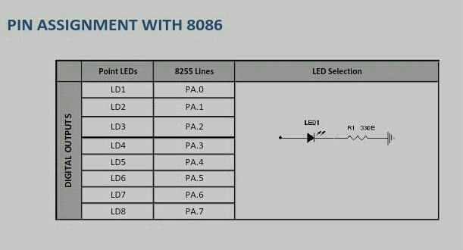
INTERFACING THE LED WITH 8086:
we now want to flash a LED in 8086 trainer boarde. It works by turning ON a LED & then turning it OFF & then looping back to START. However the operating speed of microprocessor is very high.
PIN ASSIGNMENT WITH 8086:

Slide 9
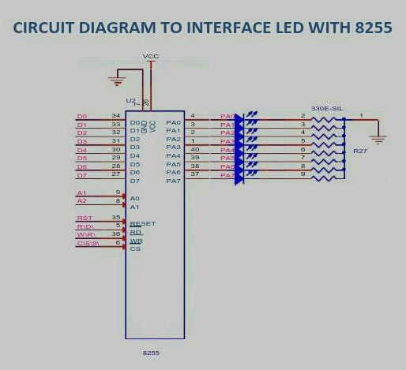
CIRCUIT DIAGRAM TO INTERFACE LED WITH 8255:

Slide 10
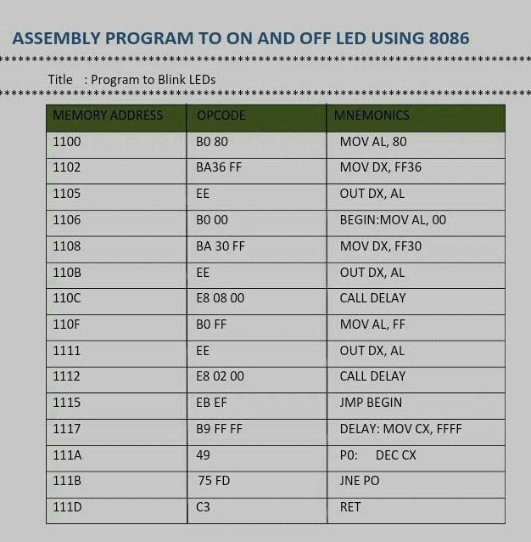
ASSEMBLY PROGRAM TO ON AND OFF LED USING 8086:

Slide 11
CONCLUSION:
With the output different input output modes and control word format has been studied in this experiment.

Slide 12
REFERENCE:
Dougles v hall,microprocessor and interfacing.new delhi:tat mc graw hill pvt.ltd.revised second edition 2010.
Rk sharma,” a low cost seven display system”,IET radio and electronic engineer,vol.41.pp.223-224 may 1971.

